Slide 1
Interplanetary File System (IPFS)
By AltoTech

Slide 2
Agenda
Introduction to IPFS
IPFS Installation
Basic Use
Mutable File System (MFS)
IPFS Demo
Build Fully decentralized

Slide 3
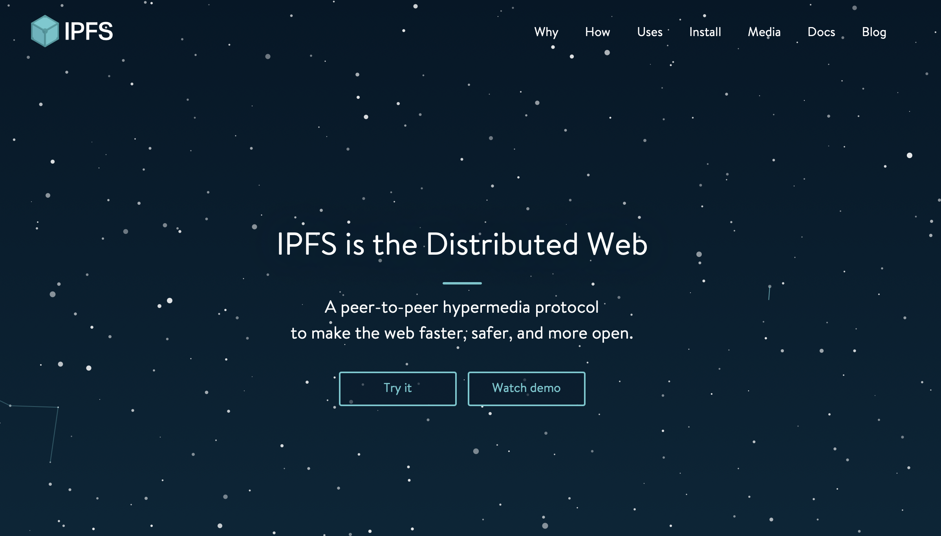
IPFS - Introduction (https://ipfs.io)

Slide 4
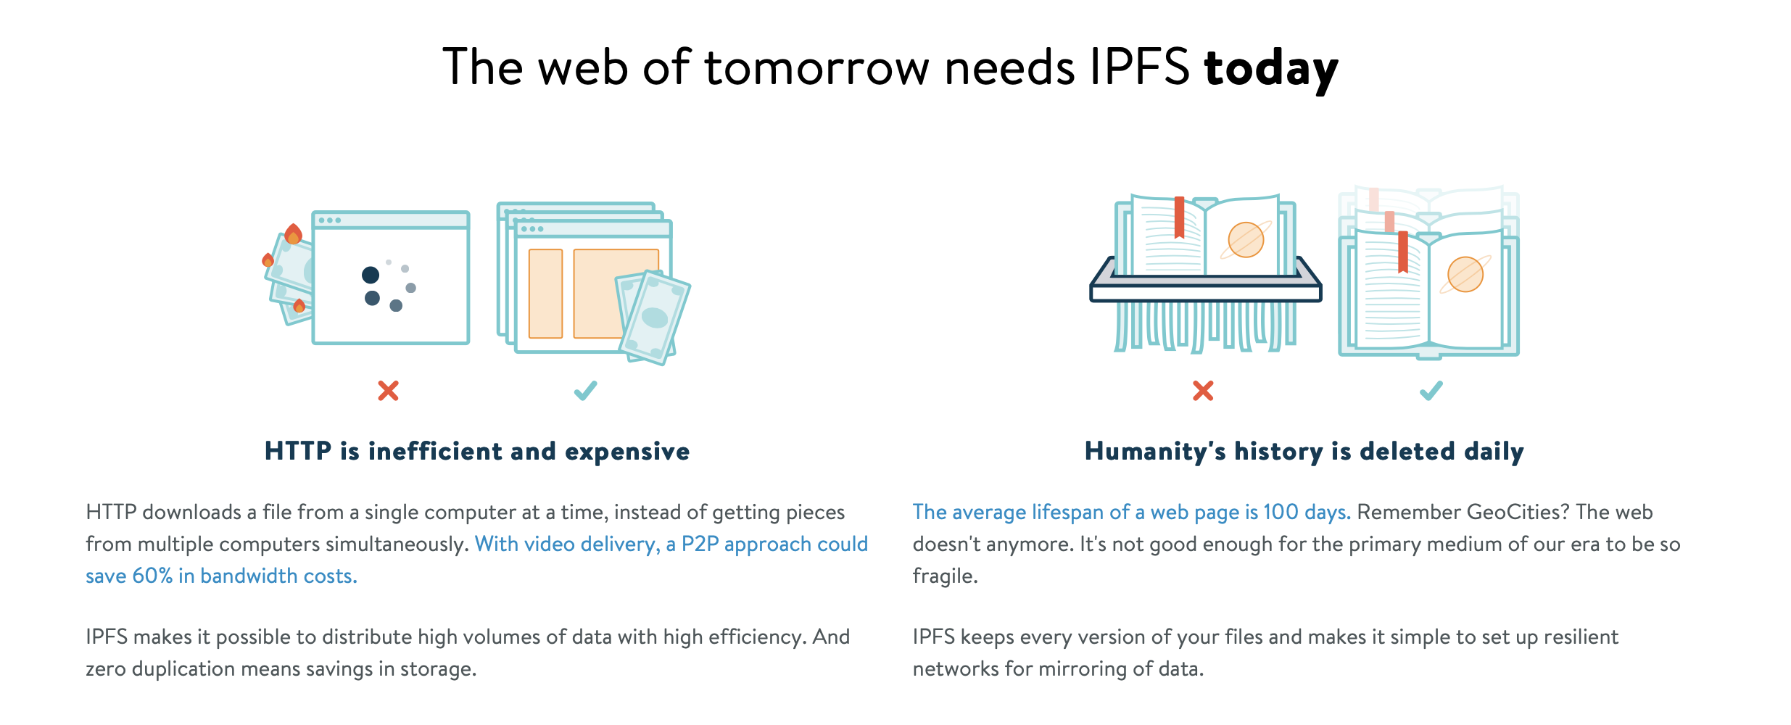
IPFS - Introduction (https://ipfs.io)

Slide 5
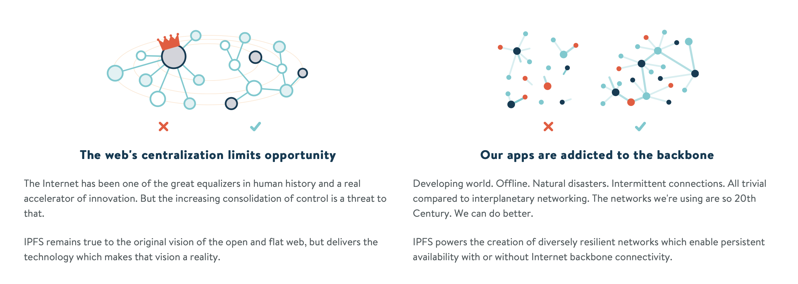
IPFS - Introduction (https://ipfs.io)

Slide 6
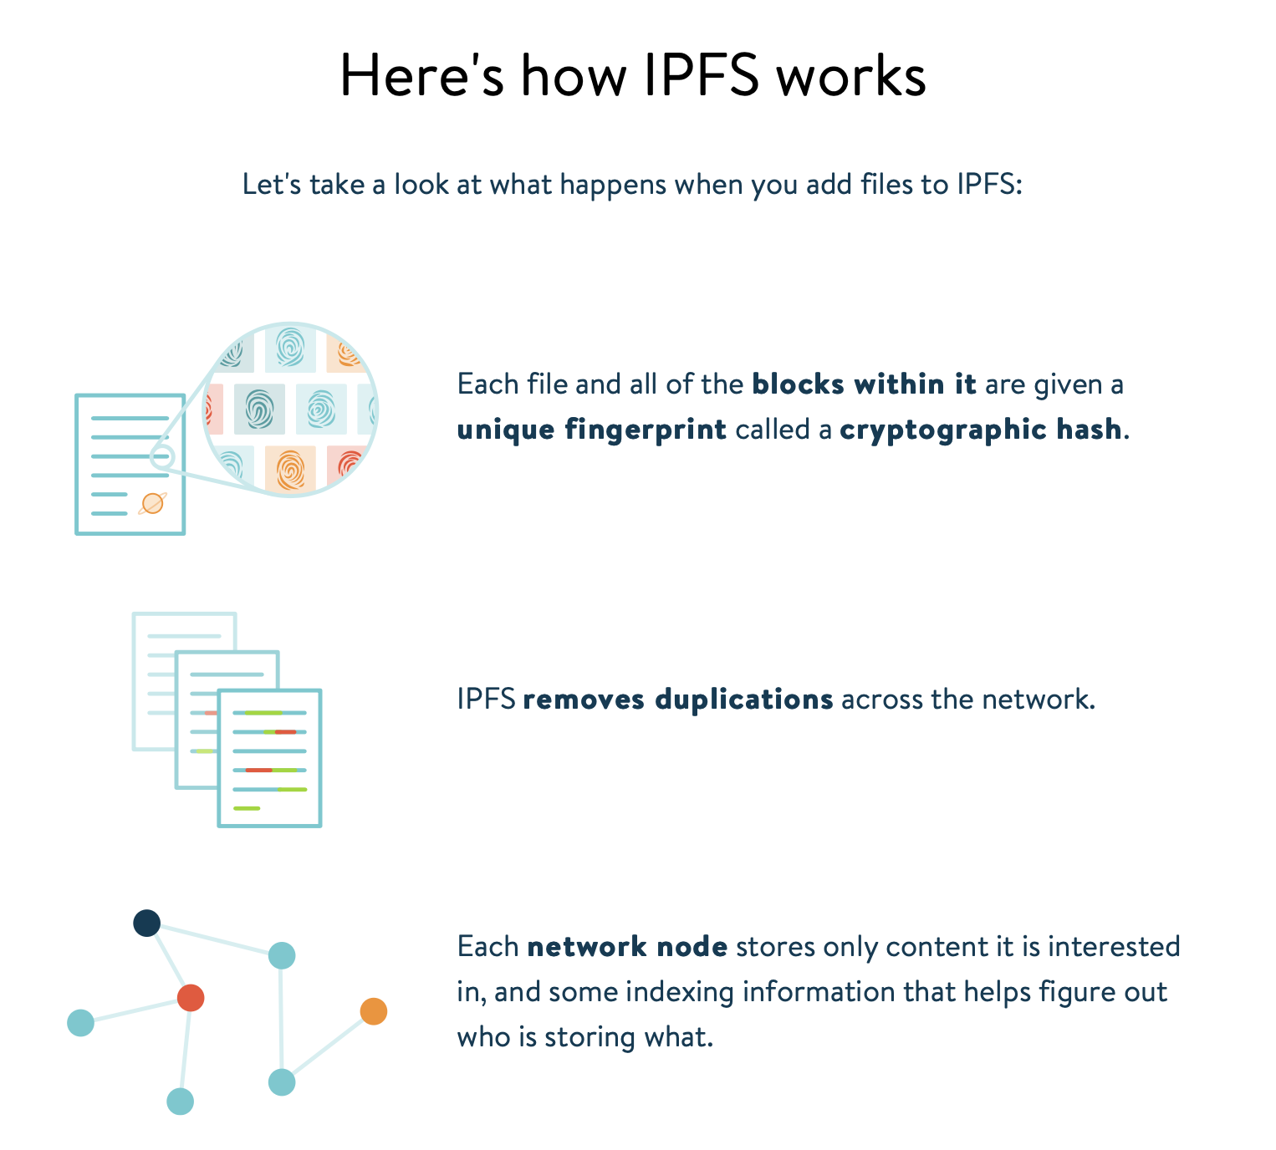
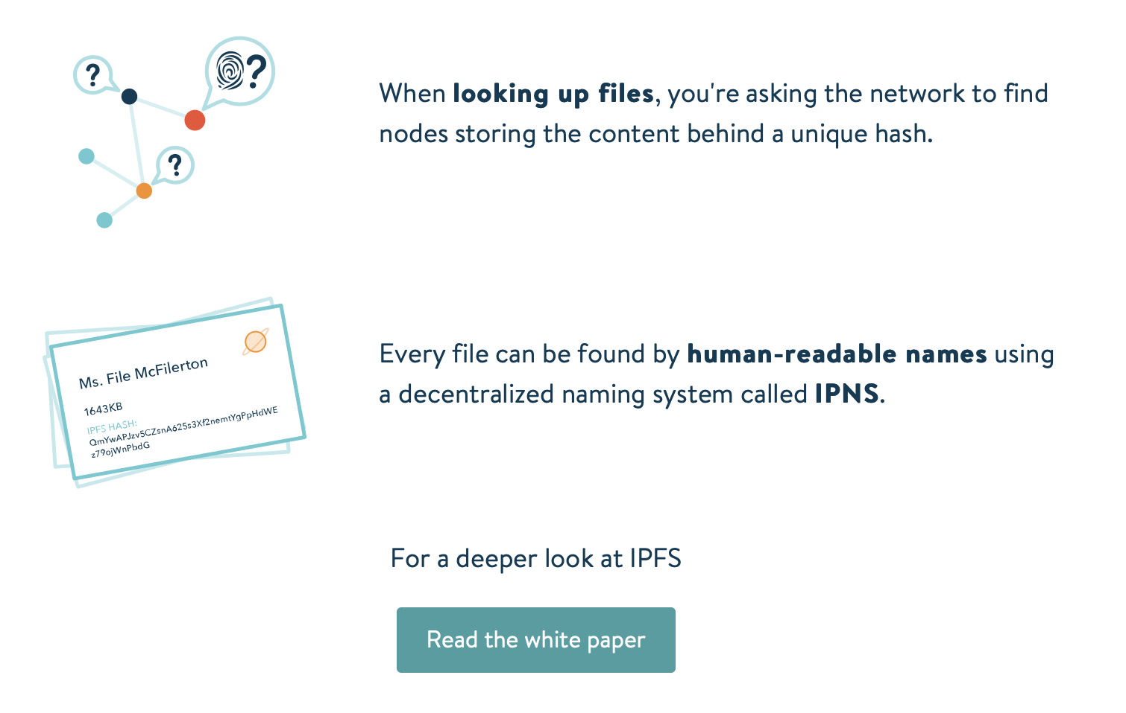
IPFS - Introduction (https://ipfs.io)

Slide 7
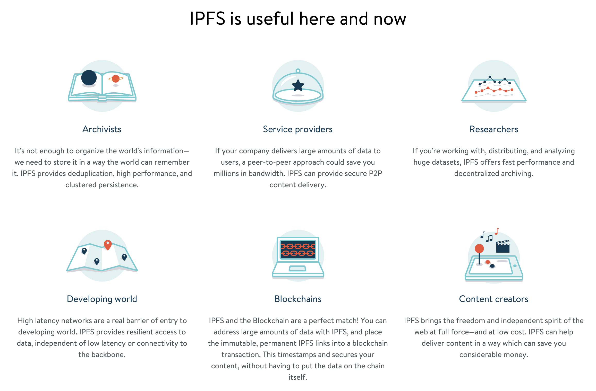
IPFS - Introduction (https://ipfs.io)

Slide 8
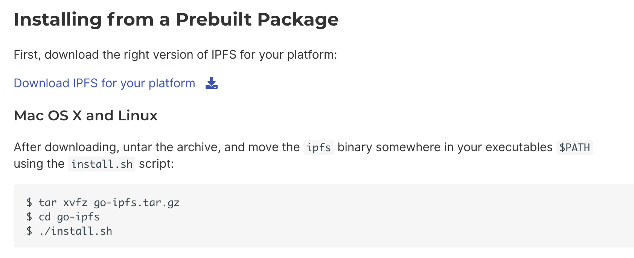
Lab1: Getting Started with IPFS
https://docs.ipfs.io/introduction/install/

Slide 9
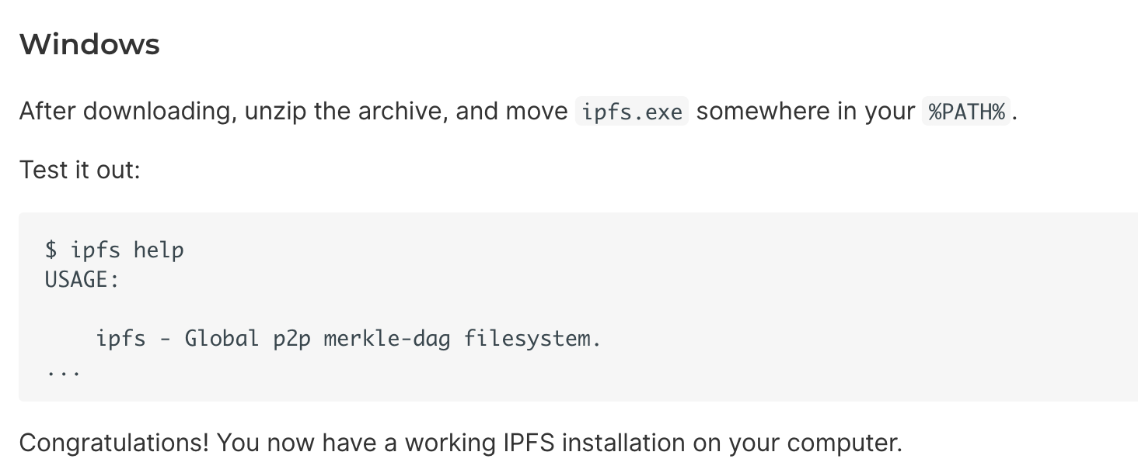
Lab1: Getting Started with IPFS

Slide 10
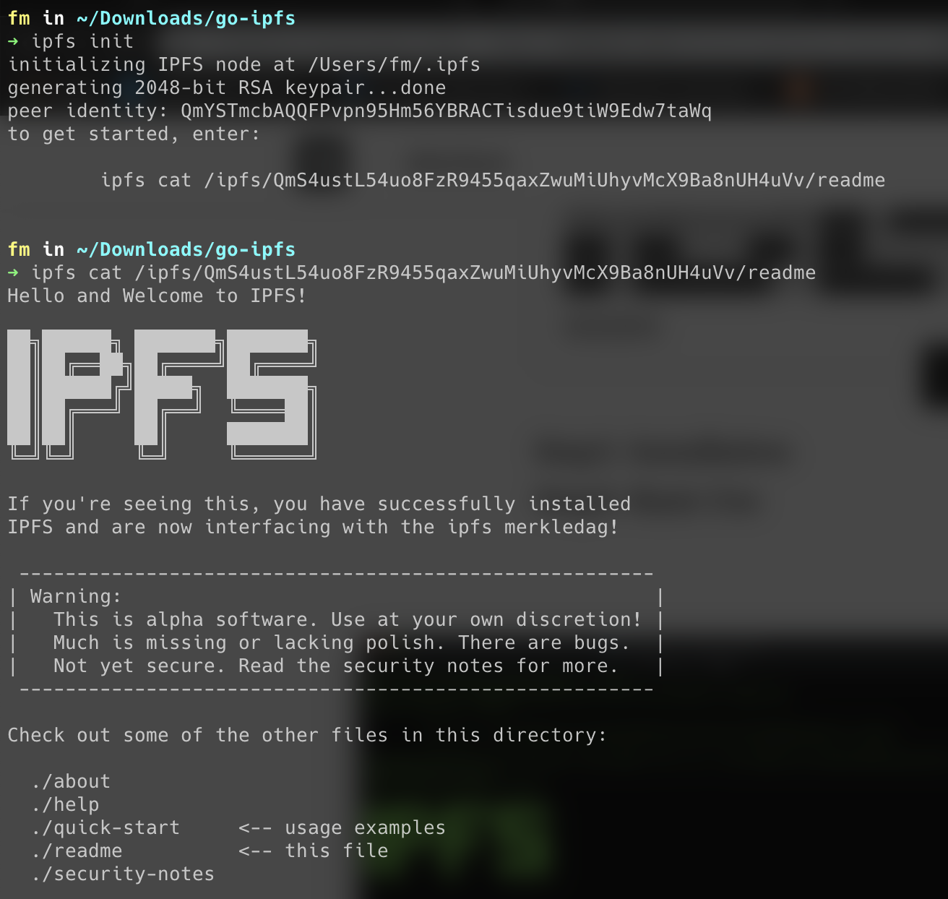
Lab1: Getting Started with IPFS
$ ipfs init
$ ipfs cat

Slide 11
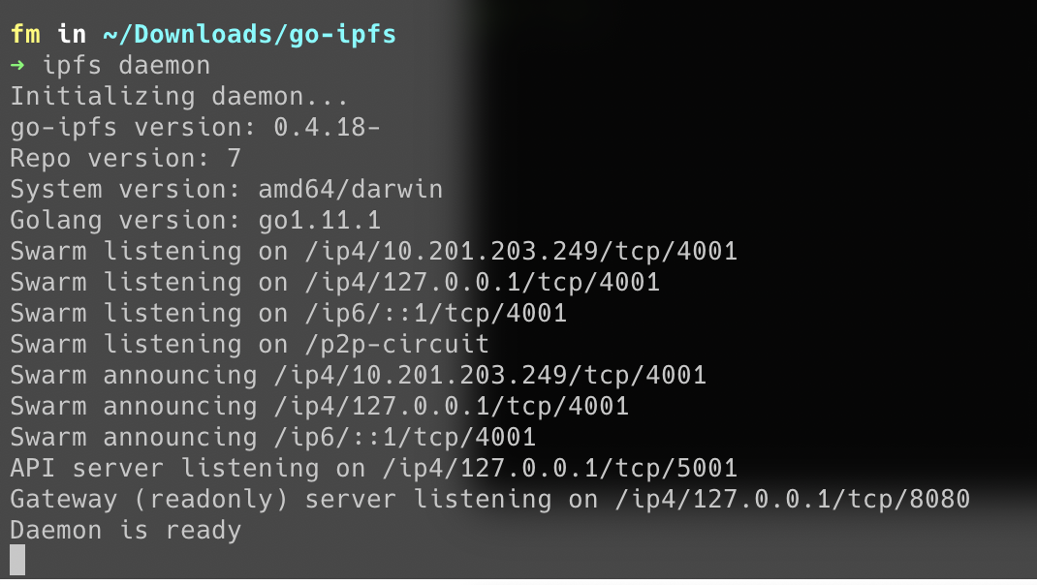
Lab1: Getting Started with IPFS
$ ipfs daemon

Slide 12
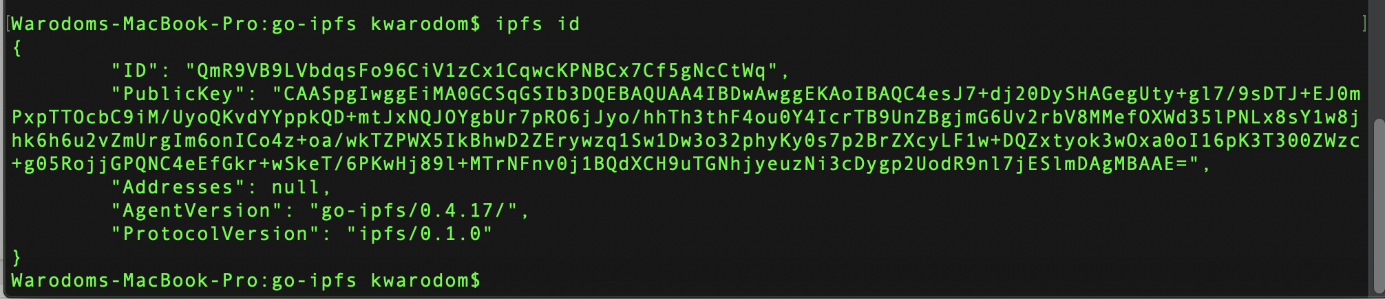
Lab1: Getting Started with IPFS
$ ipfs id

Slide 13
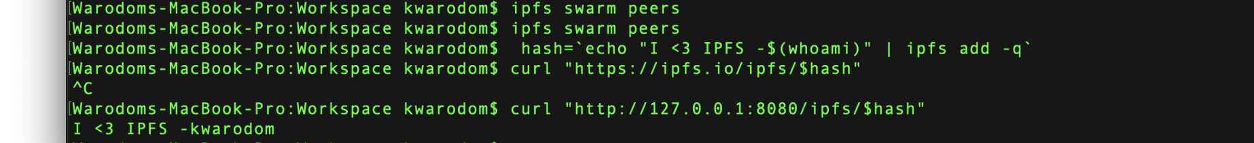
Lab1: Getting Started with IPFS
Add files to IPFS

Slide 14
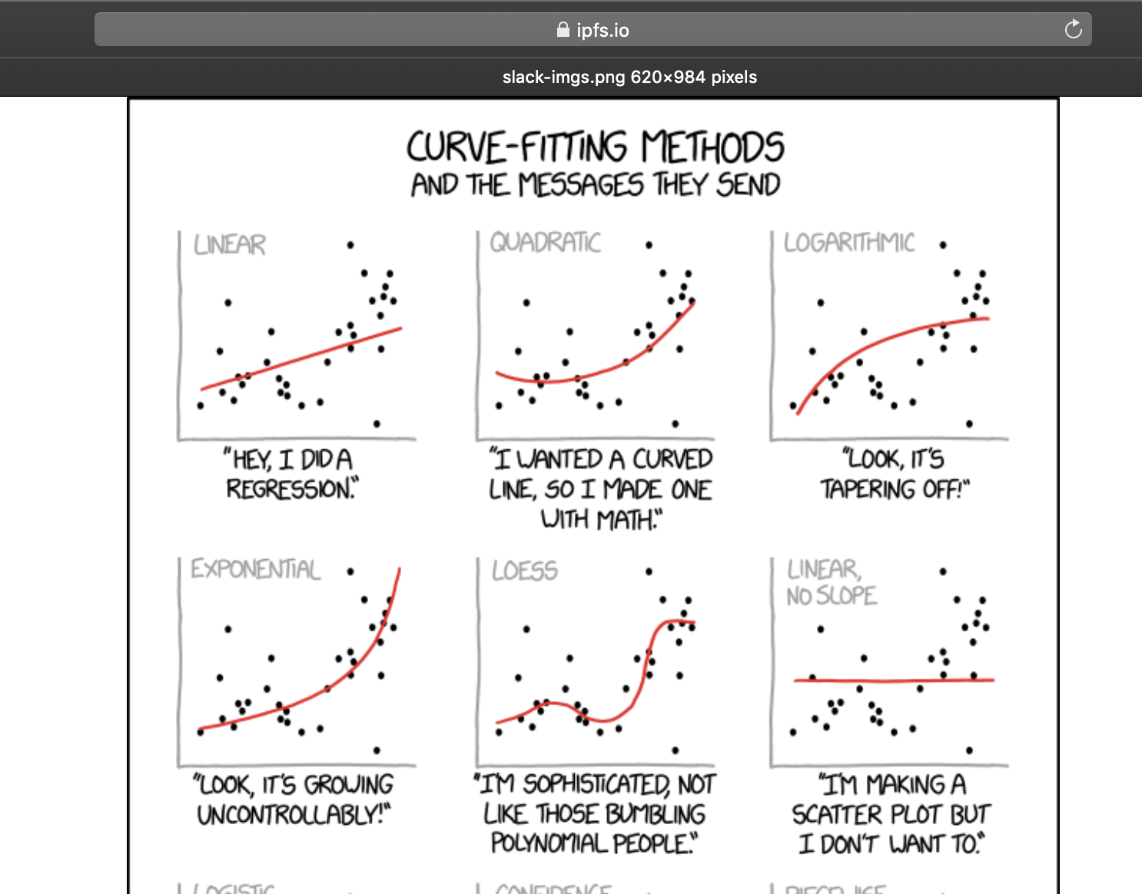
Lab1: Getting Started with IPFS
Add files to IPFS

Slide 15
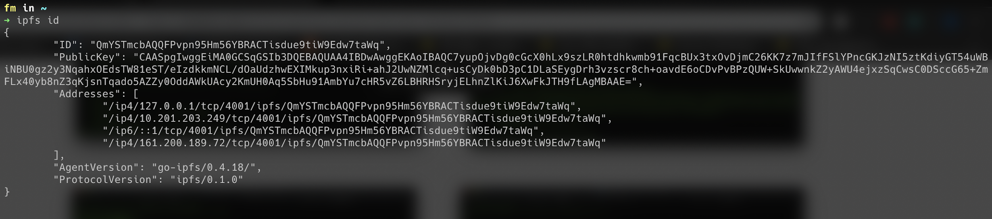
Step5: Start IPFS Server

Slide 16
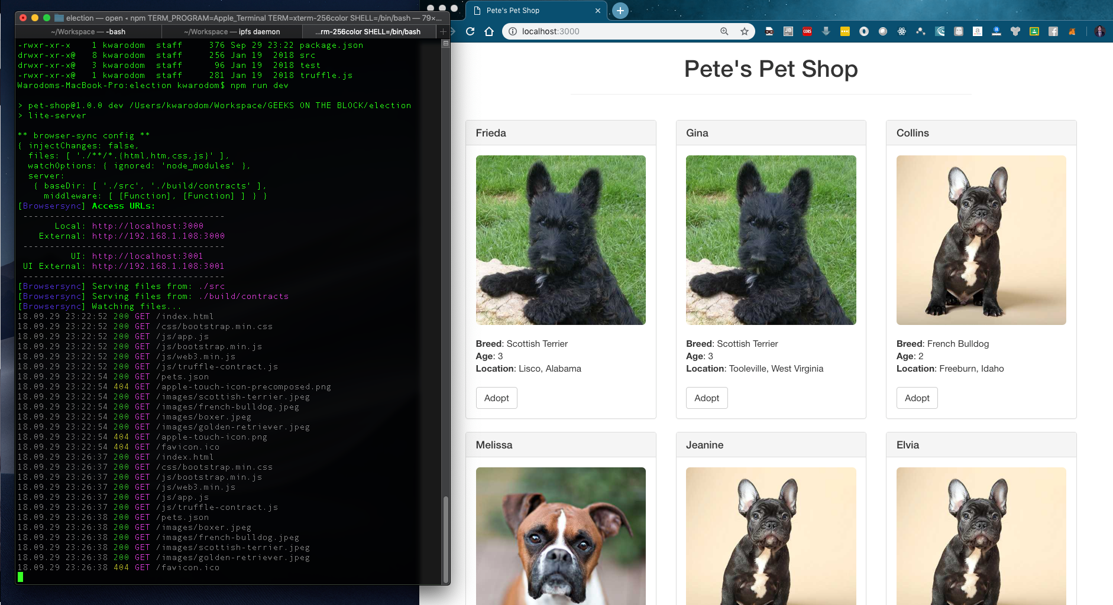
LAB - DAPP Development with IPFS
https://medium.com/p/74d4fac70e18/edit

Slide 17
LAB - DAPP Development with IPFS
Step1: Install dependencies
Step2: Install Ganache
Step3: Install Metamask
Step4: Start writing smart contract
Step5: Start IPFS server
https://medium.com/p/74d4fac70e18/edit

Slide 18
Step1: Install Dependencies
# node
$ node -v
# install truffle
$ npm install -g truffle
https://medium.com/p/74d4fac70e18/edit

Slide 19
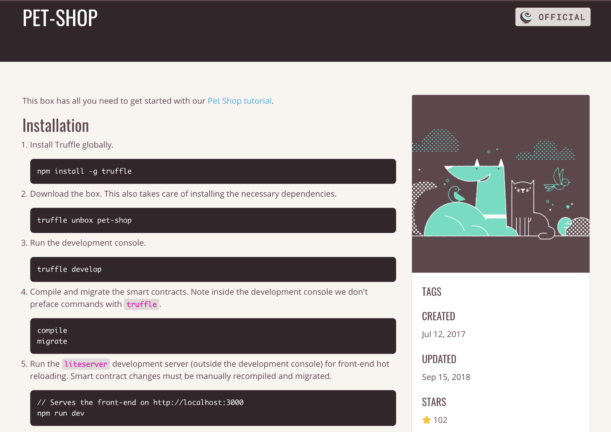
Step1: Install dependencies

Slide 20
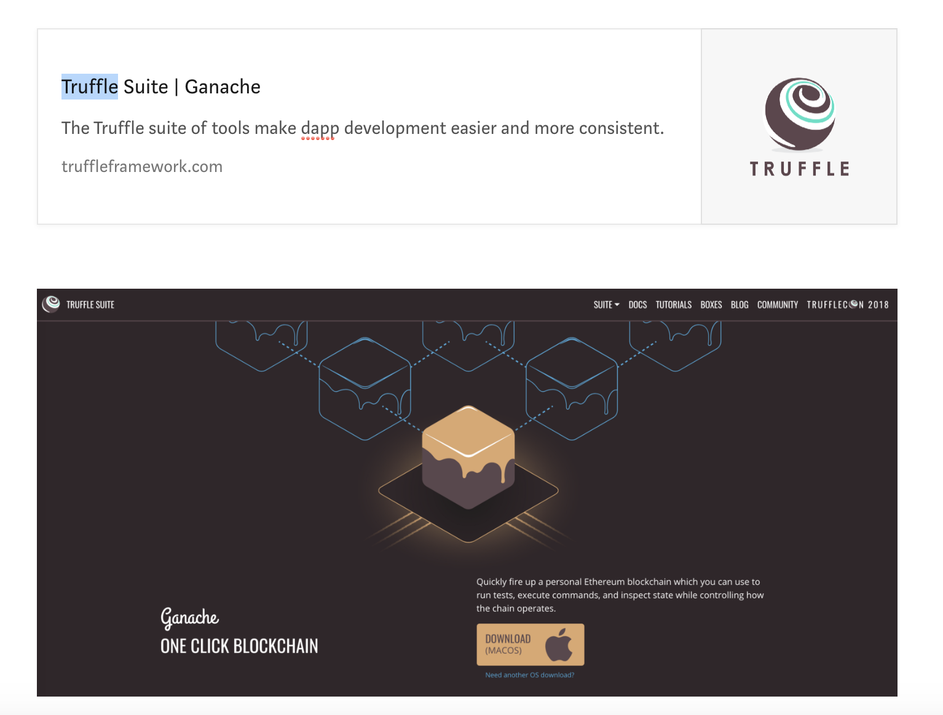
Step2: Install Ganeche

Slide 21
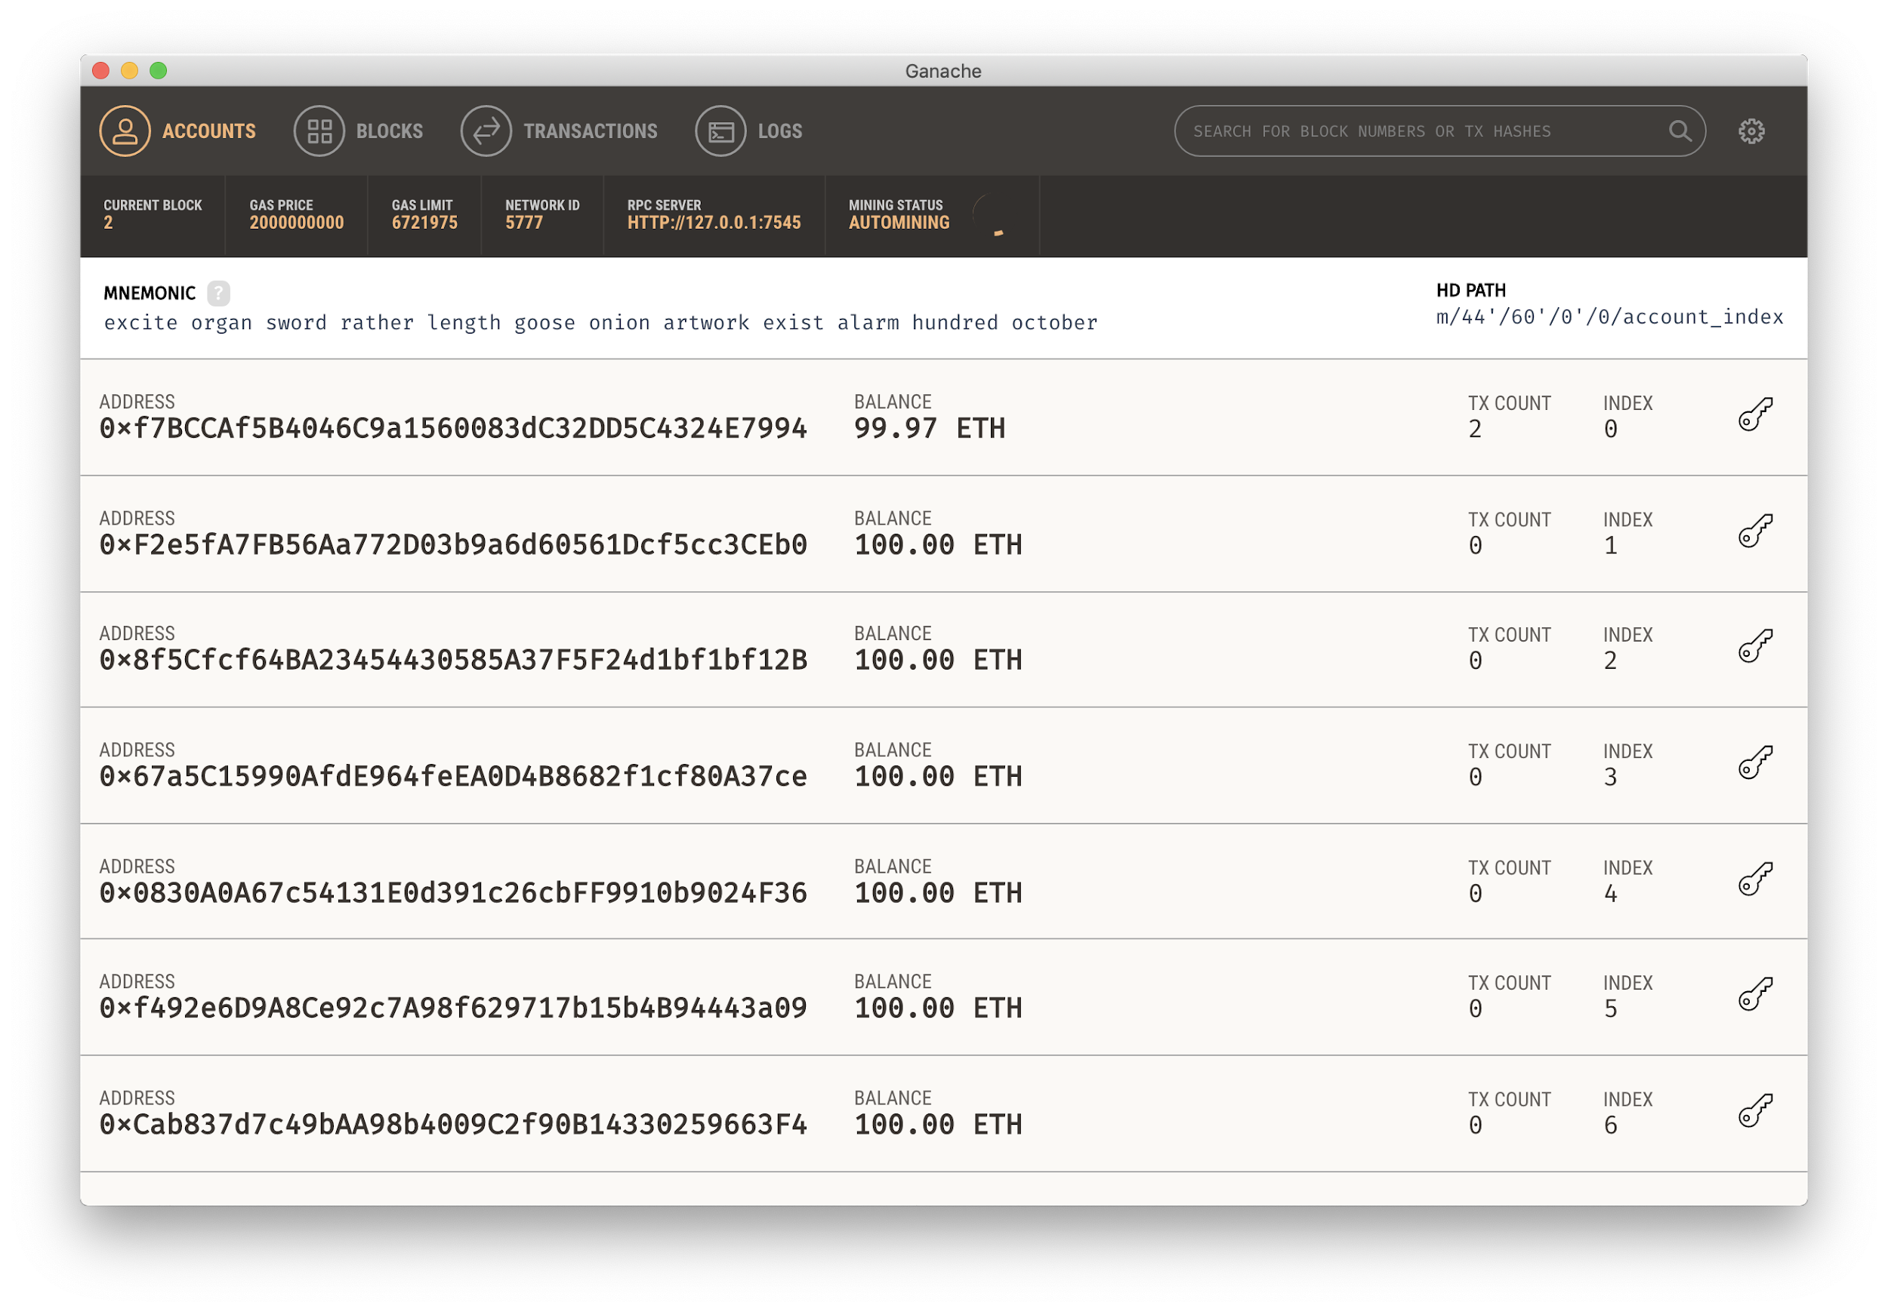
Step2: Install Ganeche

Slide 22
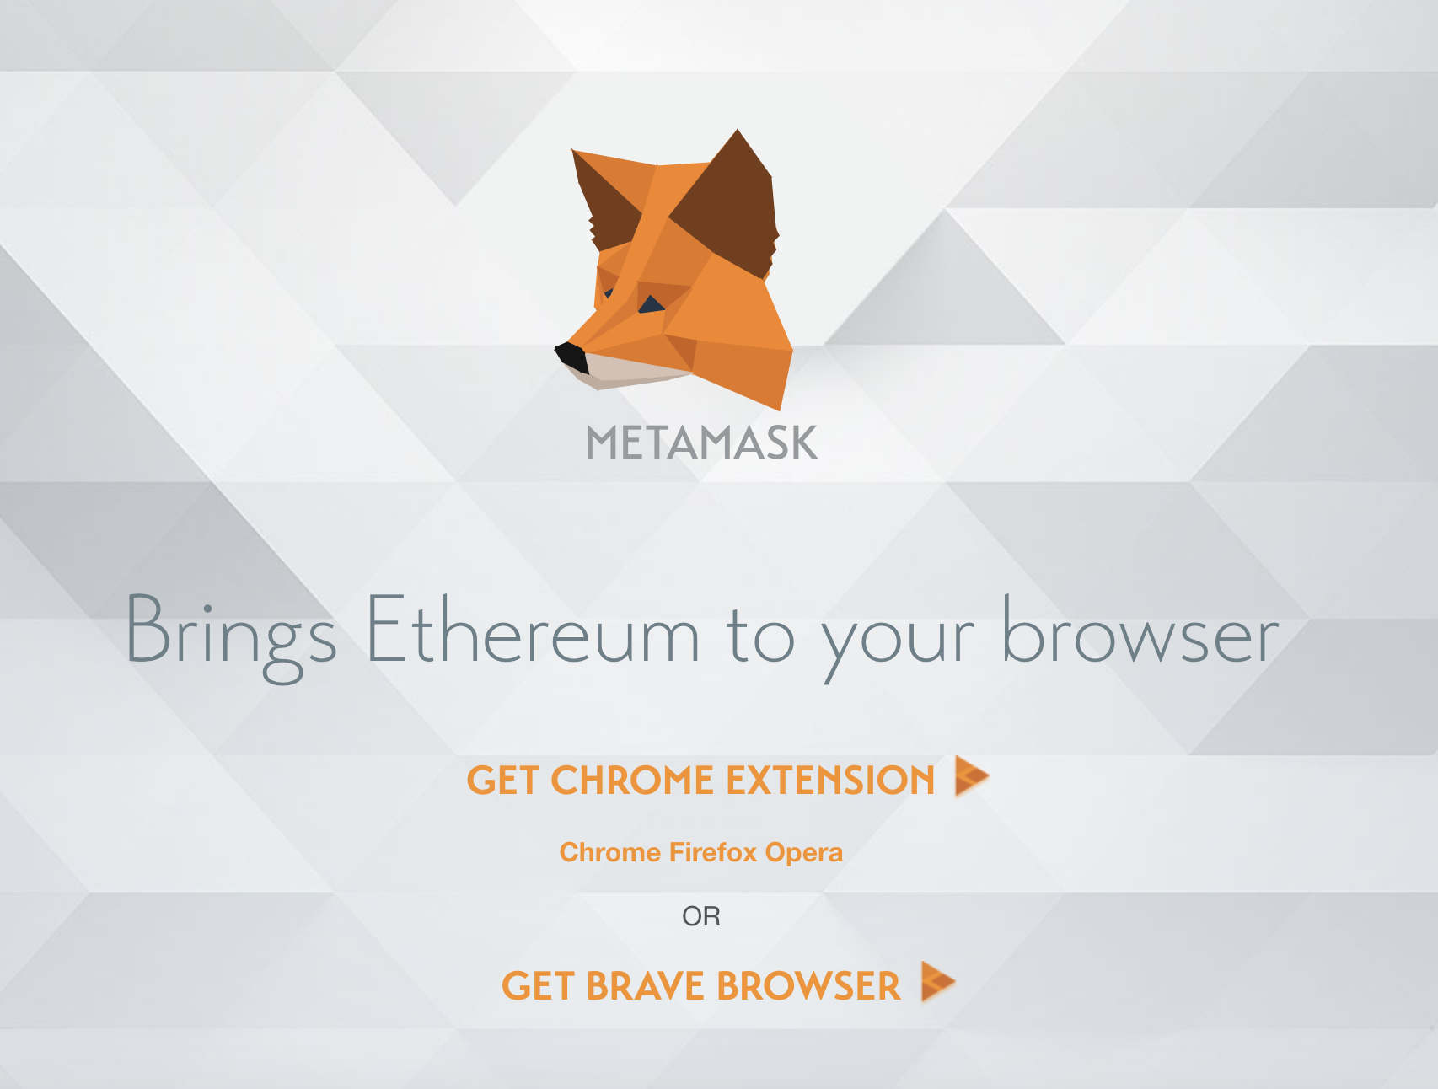
Step3: Install Metamask

Slide 23
Step4: Start writing smart contract
$ mkdir pet-shop
$ cd pet-shop

Slide 24
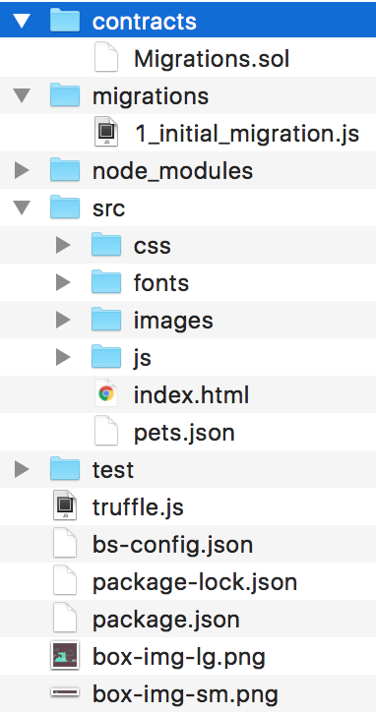
Step4: Start writing smart contract
Contracts directory: this is where all smart contacts live. We already have a Migration contract that handles our migrations to the blockchain.
Migrations directory: this is where all of the migration files live. These migrations are similar to other web development frameworks that require migrations to change the state of a database. Whenever we deploy smart contracts to the blockchain, we are updating the blockchain's state, and therefore need a migration.
Node_modules directory: this is the home of all of our Node dependencies.
Src directory: this is where we'll develop our client-side application.
Test directory: this is where we'll write our tests for our smart contracts.
truffle.js file: this is the main configuration file for our Truffle project

Slide 25
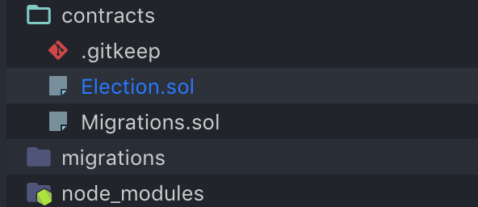
Step4: Start writing smart contract
Create file Election.sol in contracts directory.

Slide 26
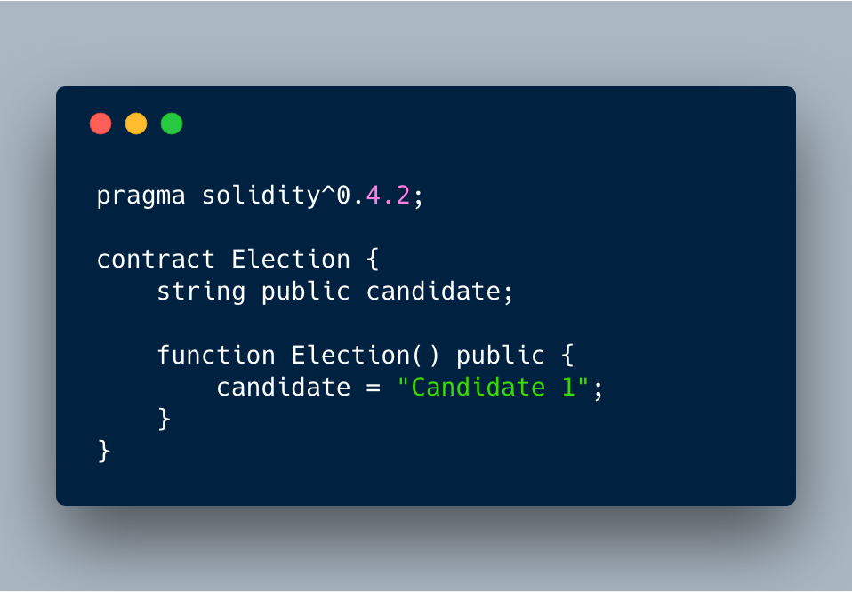
Step4: Start writing smart contract

Slide 27
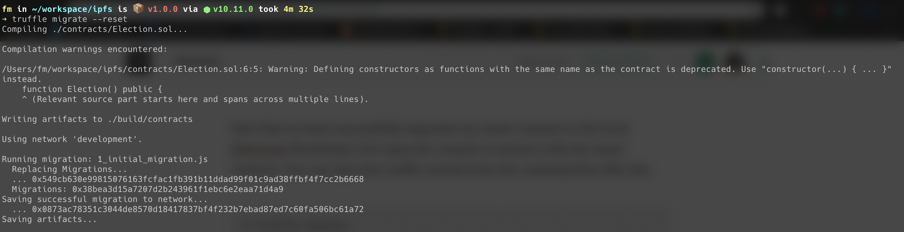
Step4: Start writing smart contract

Slide 28
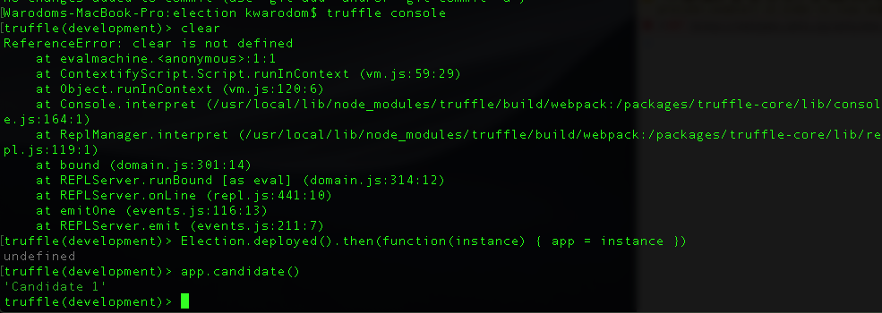
Step4: Start writing smart contract

Slide 29
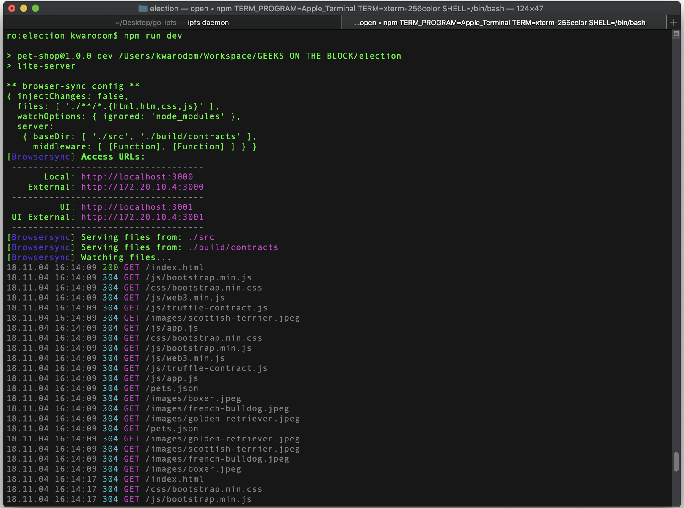
Step5: Run Local Node Js Server
$ npm run dev

Slide 30
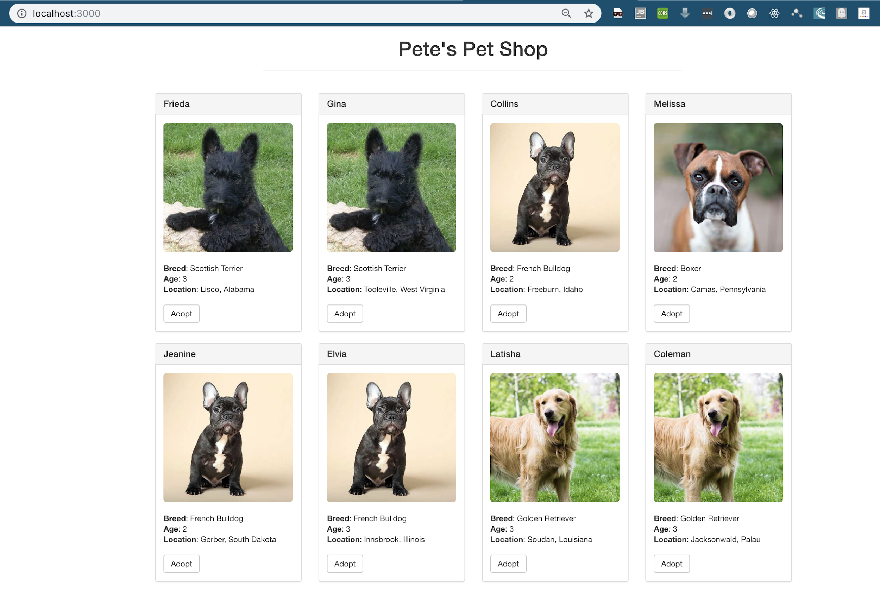
Step5: Run Local Node Js Server

Slide 31
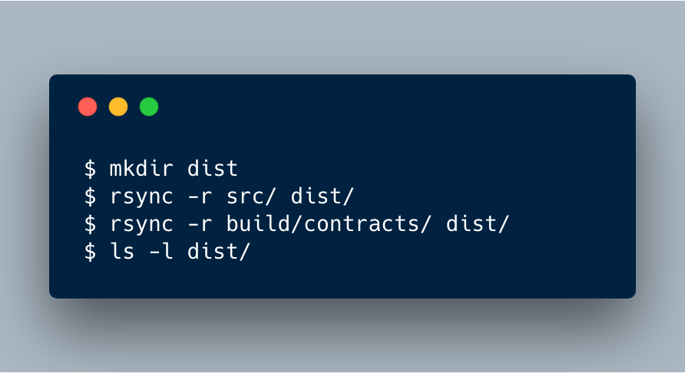
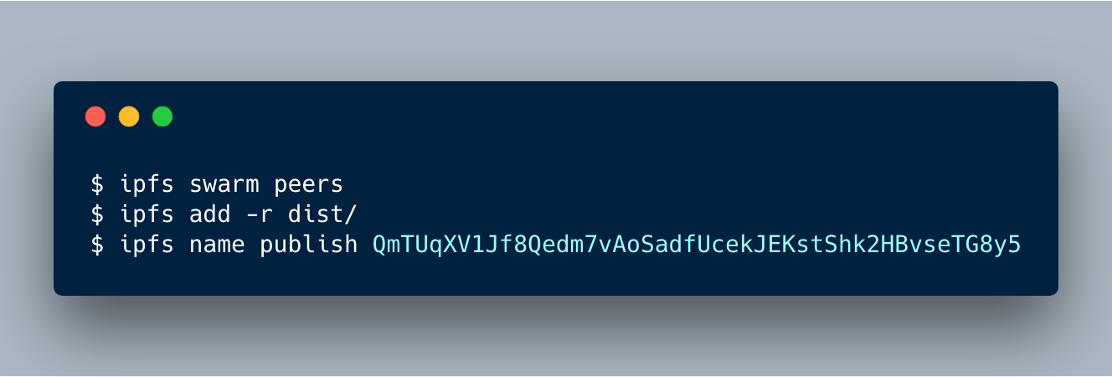
Step6: Publish to IPFS
Notes:
-r คือเอาทั้ง folder

Slide 32
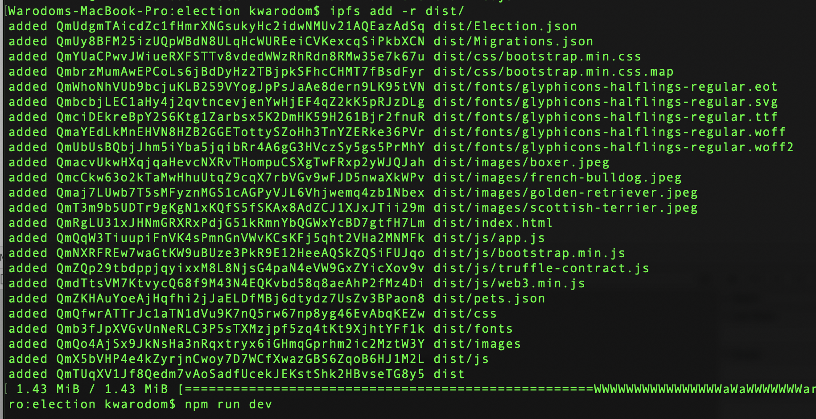
Step6: Publish to IPFS

Slide 33
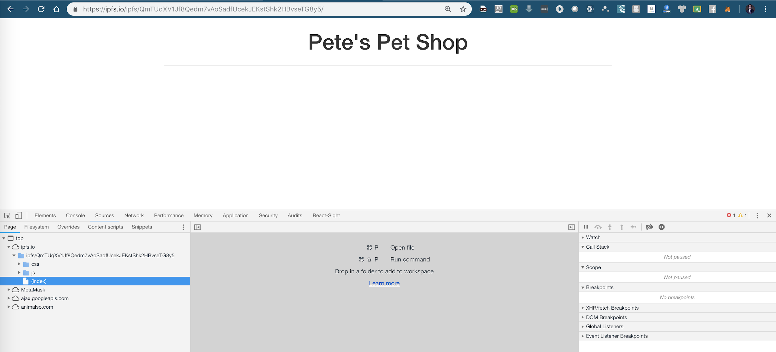
Step7: Access your web on ipfs here
You can access uploaded resources from this Merkel link

Slide 34
Step7: Access your web on ipfs here
All of you static files will be served from IPFS and can be refer to as https://ipfs.io/ipfs/QmTUqXV1Jf8Qedm7vAoSadfUcekJEKstShk2HBvseTG8y5/js/bootstrap.min.js

Slide 35
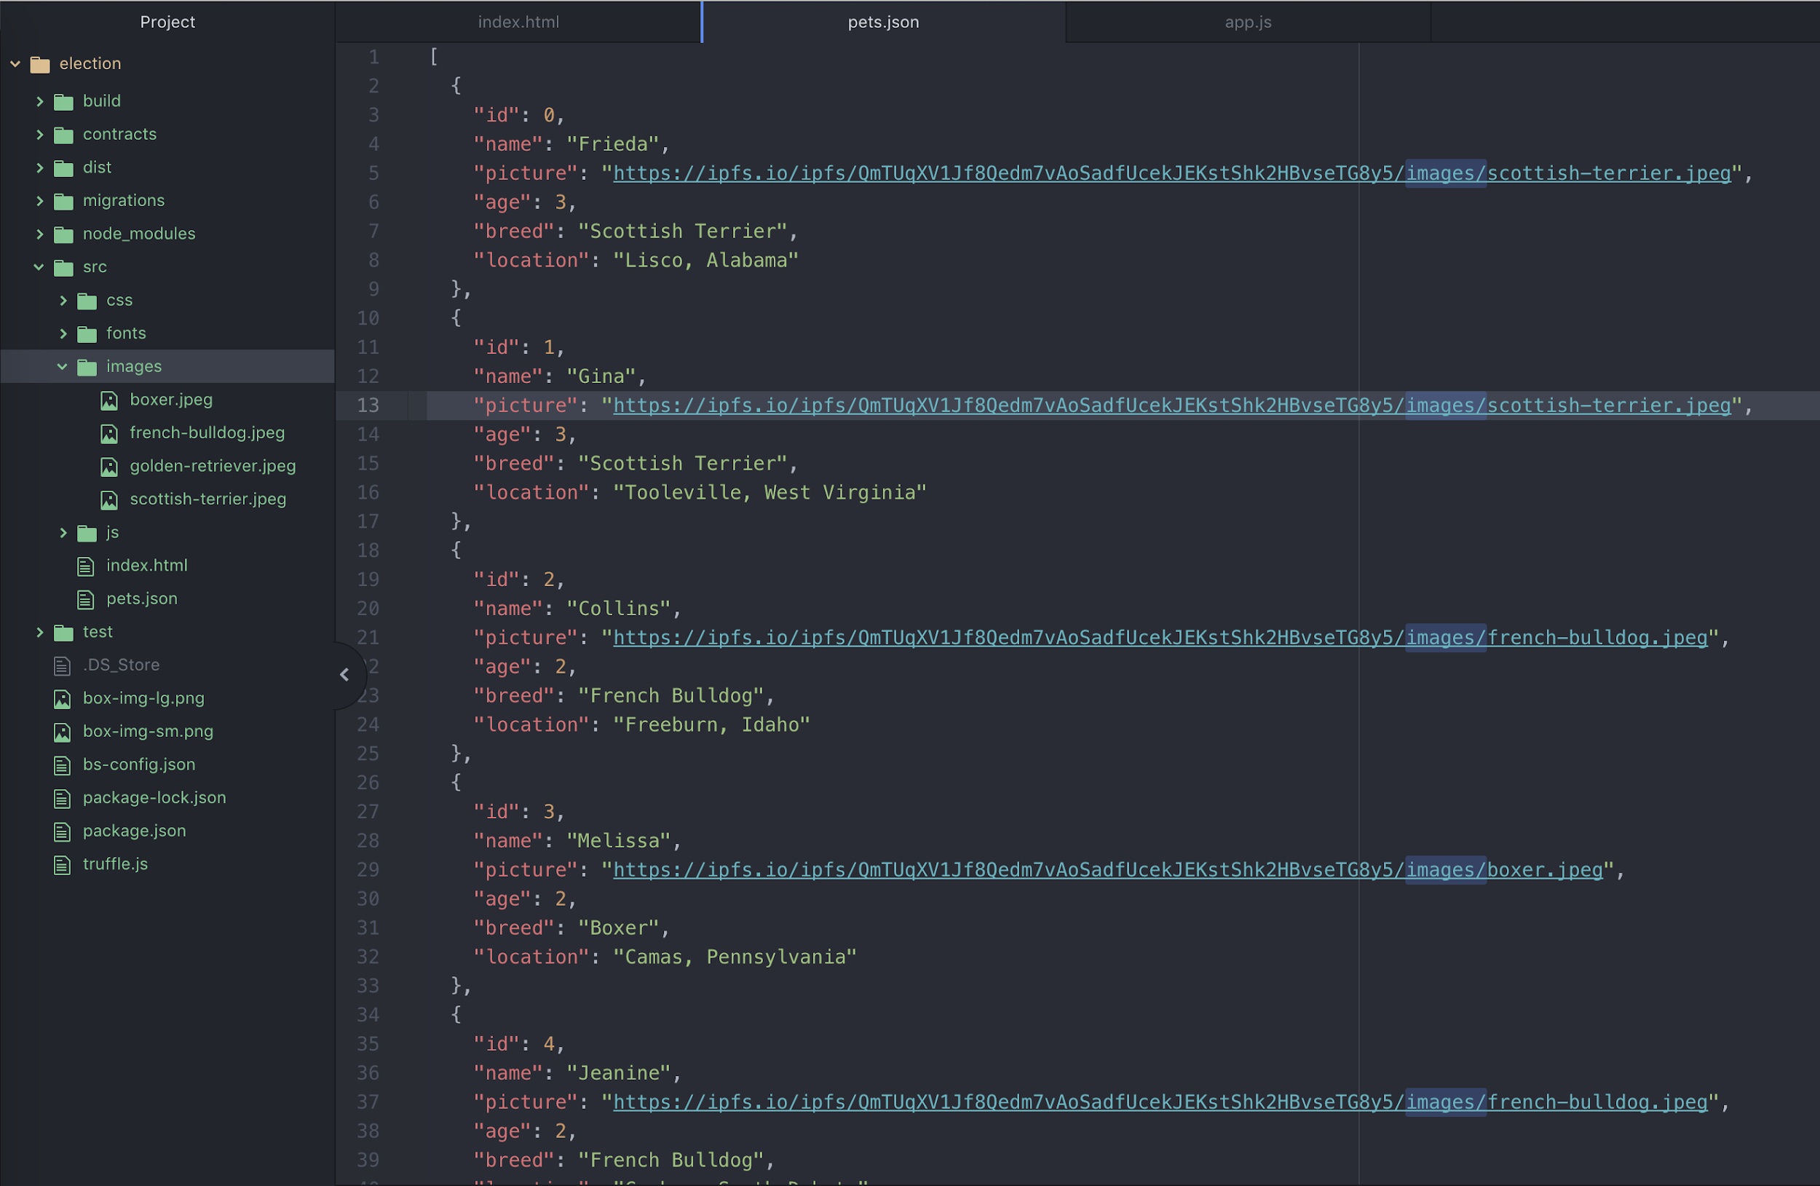
Step7: Access your web on ipfs here
You can edit pets.json to refer to static files on ipfs.io

Slide 36
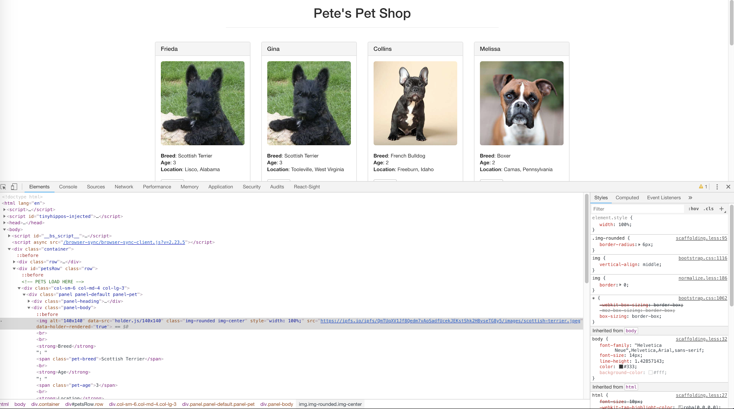
Step7: Access your web on ipfs here
This will be changed

